Slide 1
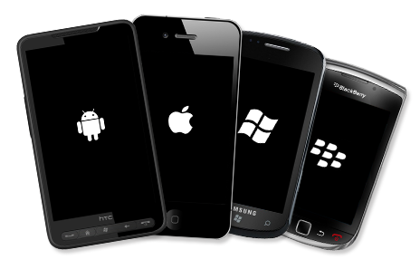
Cross-platform Mobile Development

Slide 2












Need an App ...

Slide 3
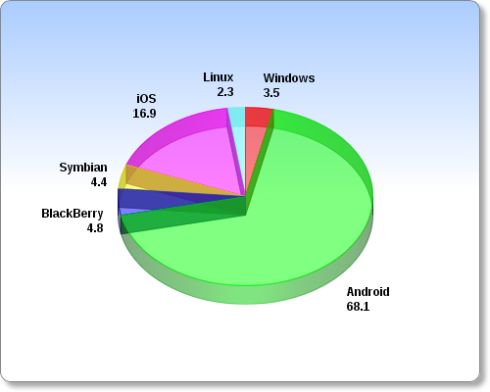
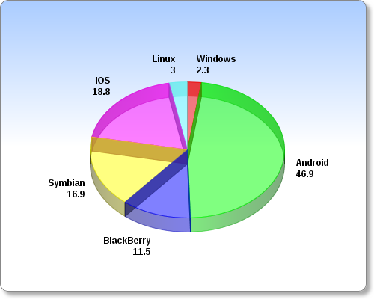
Smartphone OS Market Share
IDC, 2012 v. 2011

Slide 4

Cross-platform Mobile Development
Application types
  Native
  Web
  Hybrid
  Cross-compile

Slide 5
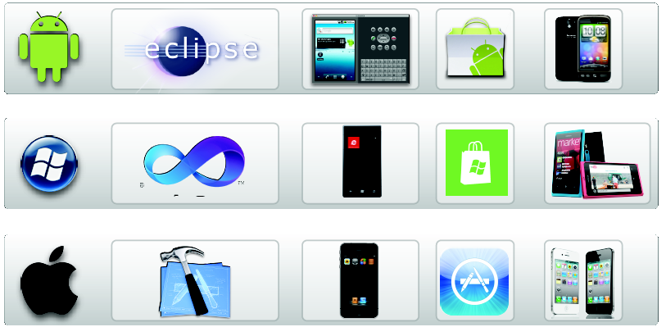
Native Apps
Built for a specific platform with the platform SDK, tools and languages, typically provided by the platform vendor

Slide 6
Native Apps
+
Speed and reaction
Native look'n'feel
Native API
Debug + Profile
-
Only 1 platform
New language?
Costs
App review time

Slide 7
When to use native app ?
Use native app if ...
  You want to achieve native look and feel
  You need top performance
  You want to be on the app store(s)

Slide 8
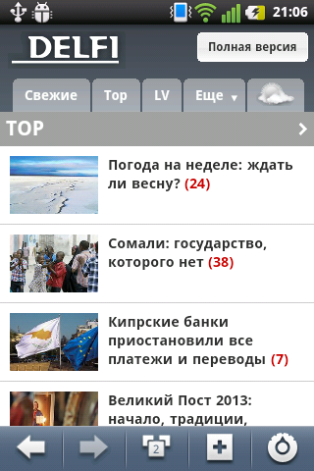

The Mobile “Server-side” Web
Uses HTML, JavaScript, CSS and runs in a devices browser

Slide 9
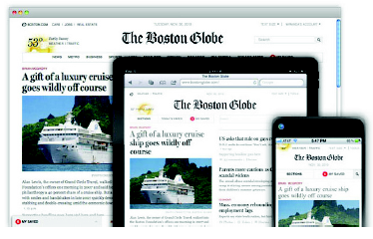
The Mobile “Server-side” Web
Responsive Design
  Dynamically loads HTML content and assets
  Serves same HTML content and assets for every device and then scales via CSS using media queries
    e.g. @media screen and (max-width: 650px)

Slide 10
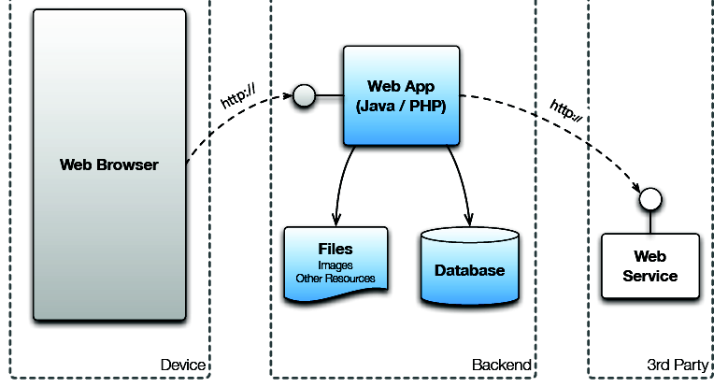
The Mobile “Server-side” Web

Slide 11
The Mobile “Server-side” Web
+
Existing tools
No license fees
All platforms with browser, even your old Nokia
Search engine
-
No app stores
Limited platform access (camera, calendar, etc)
As fast as your browser, network latency

Slide 12
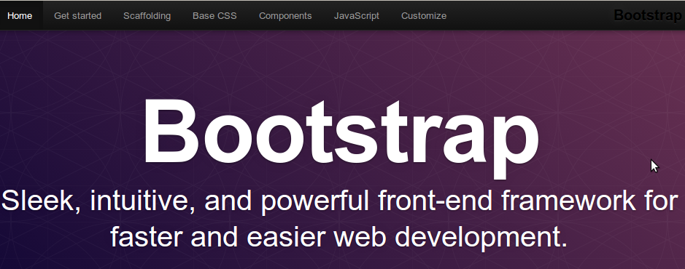

The Mobile “Server-side” Web
Twitter Bootstrap
http://twitter.github.com/bootstrap/
zurb Foundation
http://foundation.zurb.com/
Other

Slide 13
The Mobile “Server-side” Web
Use the mobile web if ...
  You need a mobile landing page for your company
  You need something that runs on almost every platform

Slide 14
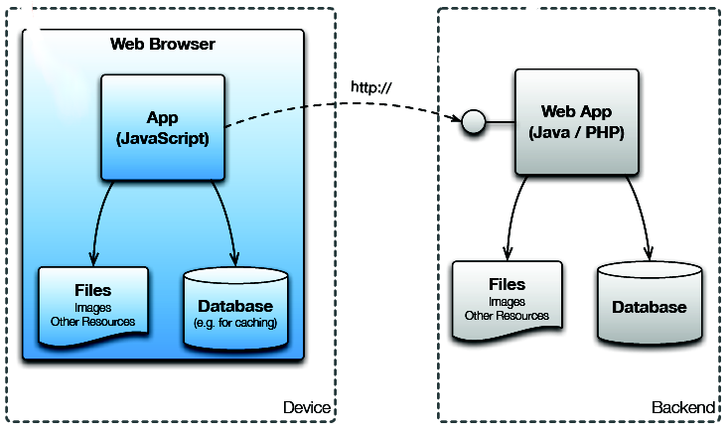

The Mobile “Client-side” Web
Uses HTML5 + JavaScript and runs in a devices browser

Slide 15

The Mobile “Client-side” Web
Sencha Touch
JQueryMobile
JQTouch
KendoUI
GWT Mobile

Slide 16
The Mobile “Client-side” Web
+
Existing tools
No license fees
All platforms with browser
Search engine
-
No app stores
Limited platform access (camera, calendar, etc)
As fast as your browser, network latency

Slide 17
The Mobile “Client-side” Web
Use the client-side web if ...
  Need something that looks like an app, but care less for the sensors of your phone
  You want to prototype a service
  You need crossplatform app (not native)

Slide 18

The Mobile “Client-side” Web
Desktop browser != Mobile browser
Safari != Chrome
Offline app storage limits
Screen rotation animation

Slide 19
The Mobile “Client-side” Web
Test on as much as possible devices !
Minimize frontend
Optimize images
Do not use jQuery only for $(“#mybutton”)
Use HTML5 features (WebStorage, WebWorker, CSS3 animations)

Slide 20
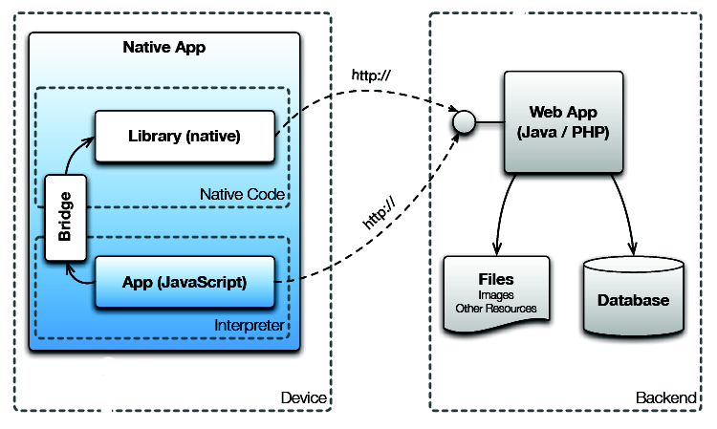
Hybrid App
HTML5 + JavaScript with a wrapper that gives it native capabilities

Slide 21
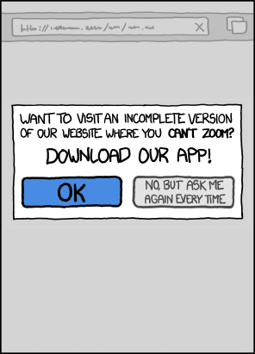
Hybrid App
Run inside a native container to leverage the device’s browser engine (but not the browser)
Web-to-native abstraction layer enables access to device capabilities

Slide 22

Hybrid App
WebView / UIWebView + self made protocol (myapp://something)
Apache Cordova (PhoneGap)
  JavaScript abstraction layer over native APIs
  An open source framework that allows you to access native APIs for iPhone, Android, BlackBerry, Windows Phone 7 + more
    Accelerometer
    Camera
    Compass
    Contacts
    Geolocation
    Notifications

Slide 23
Hybrid App
+
Existing tools
No license fees
All platforms with browser
Search engine
-
As fast as your browser, network latency

Slide 24
Hybrid App
Use hybrid approach if ...
  You want to build your app based on HTML5
  And need access to the phone's hardware

Slide 25

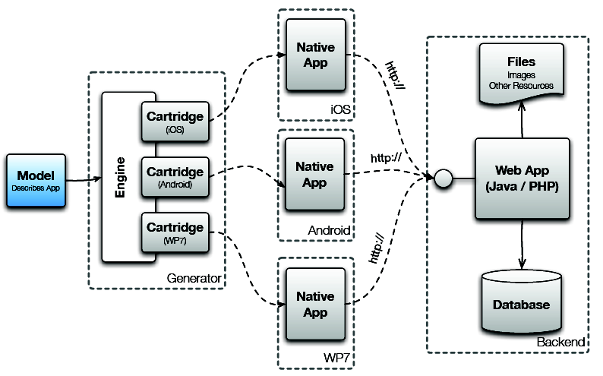

Interpreted and cross-compile

Slide 26
Interpreted and cross-compile
Appcelerator Titanium
    JavaScript -> Native + Hybrid JS
MonoTouch
    C# -> Native
Apache Thrift
    Thrift definition -> Native
QT

Slide 27
Interpreted and cross-compile
Use interpreted or cross-compiled app if ...
  You want to use “one language to build them all”
  Need access to the phone's hardware
  Need semi- or truly native look and feel / performance

Slide 28
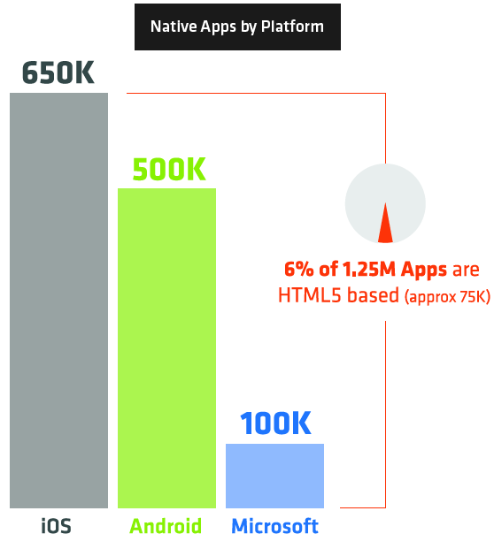
Decision
Factors
  App size and type
  Platforms
  Developers skills
  Budget
  Monetization
  User experience
  Importance of updates

Slide 29
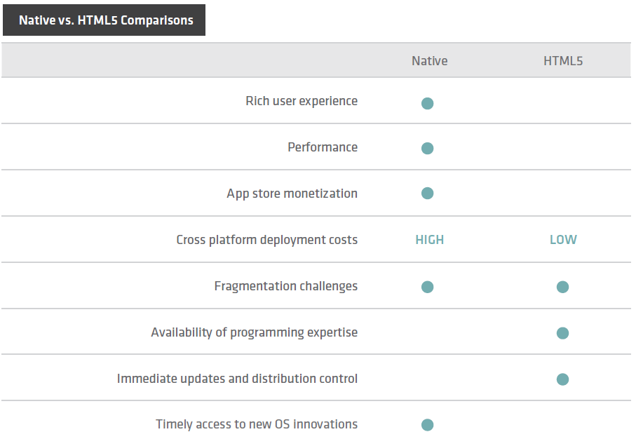
Decision

Slide 30

Sencha Touch

Slide 31
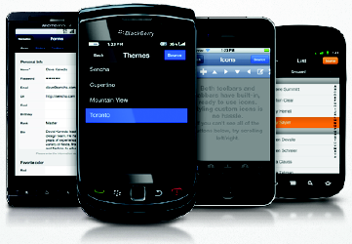
Sencha Touch
JavaScript framework for building rich mobile apps with web standards
Produce a native-app-like experience inside a browser
Usually enables to quickly create HTML5 based mobile apps that work on Android, iOS and Blackberry devices

Slide 32


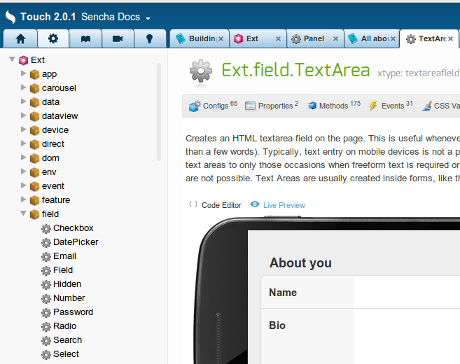
Features
Cross-platform
Looks native, feels native
Usually faster, cheaper, easier to build with
Highly customisable
Great API documentation
HTML5/CSS3

Slide 33
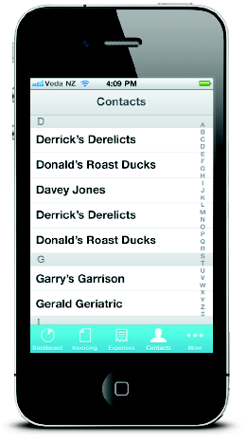
Features
Multi-touch and gesture support
Flexible deployment
Hardware accelerated, native & natural scrolling

Slide 34
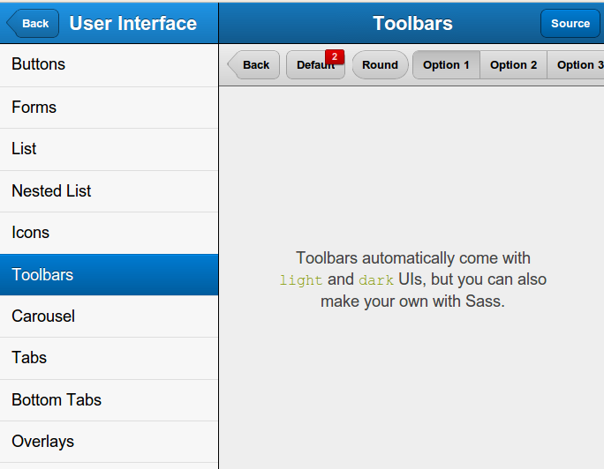
Sench Touch UI

Slide 35
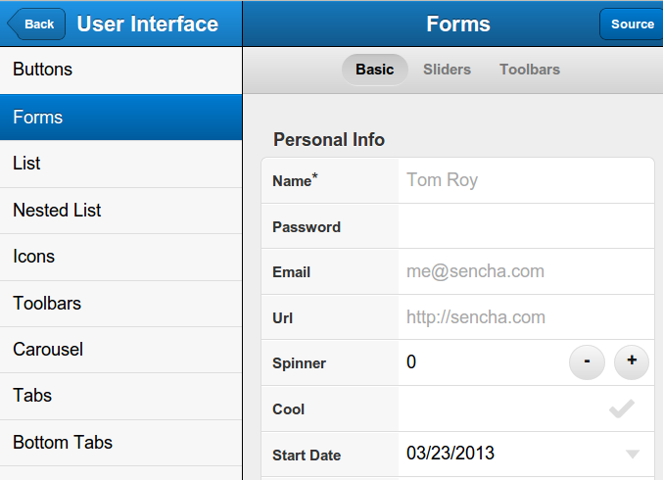
Sencha Touch UI

Slide 36
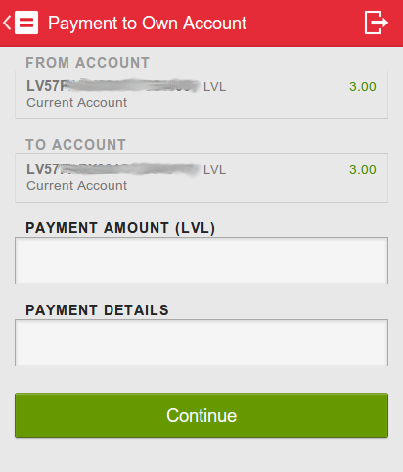
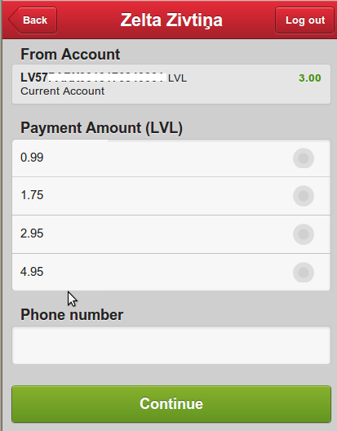
Sencha Touch UI

Slide 37

Javascript Spaghetti

Slide 38
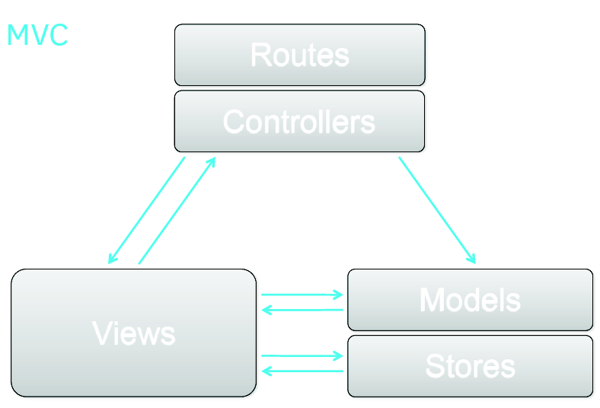
Sencha Touch Way
Building applications, not websites
Directory structure for code organization
Pure JavaScript
MVC Paradigm
Based on ExtJS 4

Slide 39
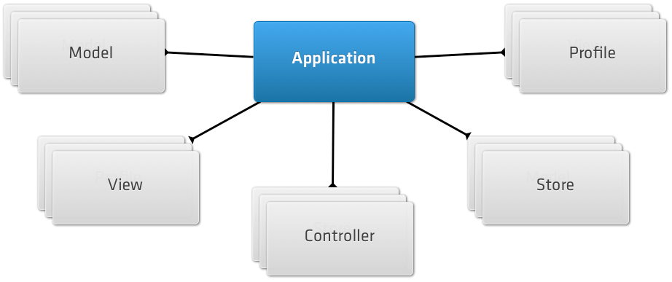
Sencha Building Blocks
Sencha Touch SDK
Sencha Touch SDK Tools

Slide 40
Sencha Building Blocks
Models: represent a type of object in your app (Users, Products)
Views: are responsible for displaying data to your users and leverage the built in Components in Sencha Touch
Controllers: handle interaction with your application, listening for user taps and swipes and taking action accordingly
Stores: are responsible for loading data into your app and power Components like Lists and DataViews

Slide 41
Start using Sencha Touch
Get a WebKit-based desktop browser
Get some emulators & real devices
Download the Sencha Touch 2
Develop against a local web server
http://www.sencha.com/products/touch

Slide 42
Resources for Practical Task
Sencha-generated.zip – application stub generated by sencha sdk tools
  Starting point for development
  Includes sdk
Tomcat (or other web-server) + Sencha.xml
  http://tomcat.apache.org/download-70.cgi
  Put Sencha.xml into tomcat/conf/Catalina/localhost
  NB! change path
    <Context path="/Sencha" docBase="YOURFOLDER/Sencha/" />

Slide 43
Resources for Practical Task
Sencha API documentation
  http://docs.sencha.com/touch/2-0/#!/api
Navigation.js, purchases.js
Sencha-minified.zip – application minified bundle for Android hybrid app

Slide 44
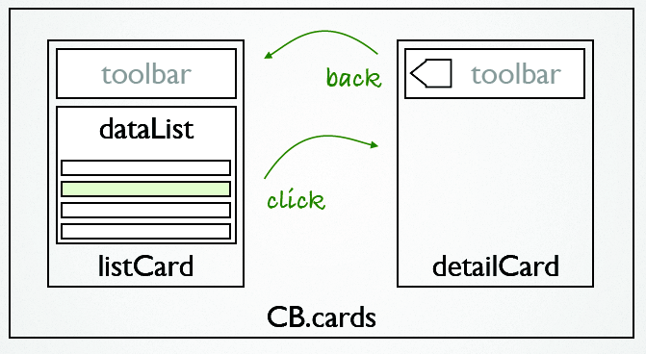
Development workflow
App architecture
UI structure
Data Modelling
List binding
List event handler
Details page
Package

Slide 45
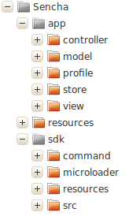
Sench Touch App Tree
App
Resources
SDK (do not touch)
app.js
.json files
index.html

Slide 46
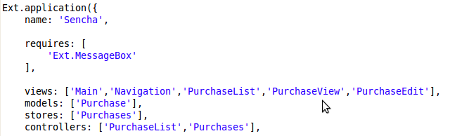
Sencha Touch / Application
The Application is usually the first thing you define in a Sencha Touch application

Slide 47
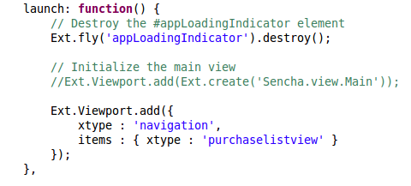
Sencha Touch / Application
Each Application can define a launch function, which is called as soon as all of your app's classes have been loaded and the app is ready to be launched

Slide 48
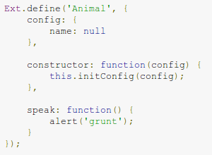
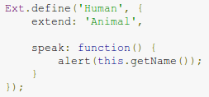

Sencha Touch / Classes
Uses the state of the art class system developed for Ext JS 4
  easy to create new classes in JavaScript
  providing inheritance, dependency loading, mixins, powerful configuration options, and lots more
Class has some functions and properties attached to it

Slide 49
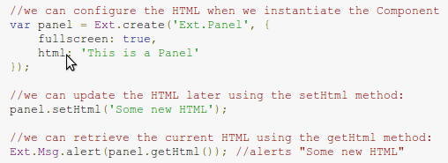
Sencha Touch / Component
Most of the visual classes in Sencha Touch are Components. Every Component in Sencha Touch is a subclass of Ext.Component
  Render themselves onto the page using a template
  Show and hide themselves at any time
  Center themselves on the screen
  Enable and disable themselves

Slide 50
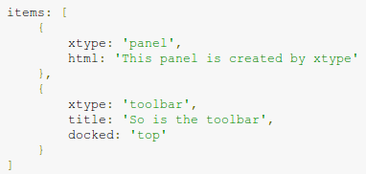
Sencha Touch / xtype
xtype is an easy way to create Components without using the full class name.
  a shorthand way of specifying a Component
  e.g., you can use xtype: 'panel' instead of typing out Ext.panel.Panel.

Slide 51
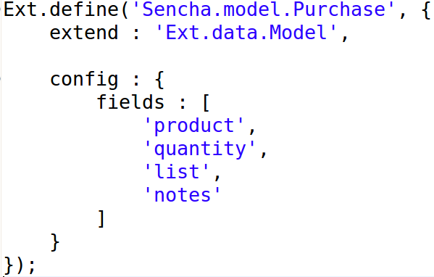
Sencha Purchase List / Model
Purchase.js

Slide 52
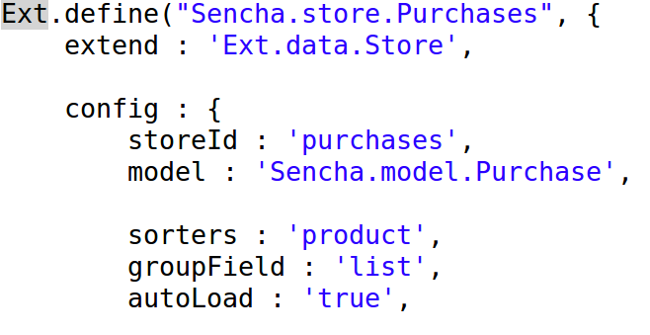
Sencha Purchase List / Store
Purchases.js

Slide 53
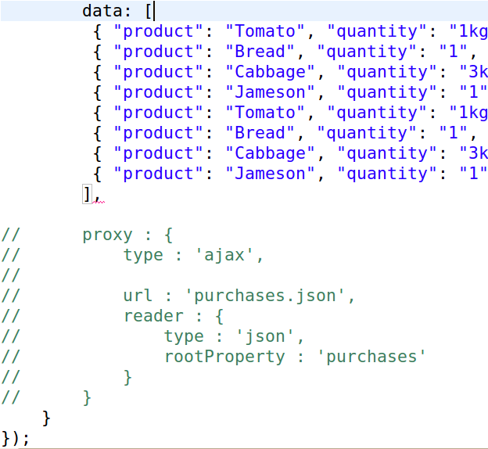
Sencha Purchase List / Store

Slide 54
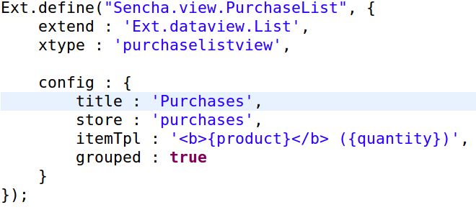
Sencha Purchase List / View
PurchaseList.js

Slide 55
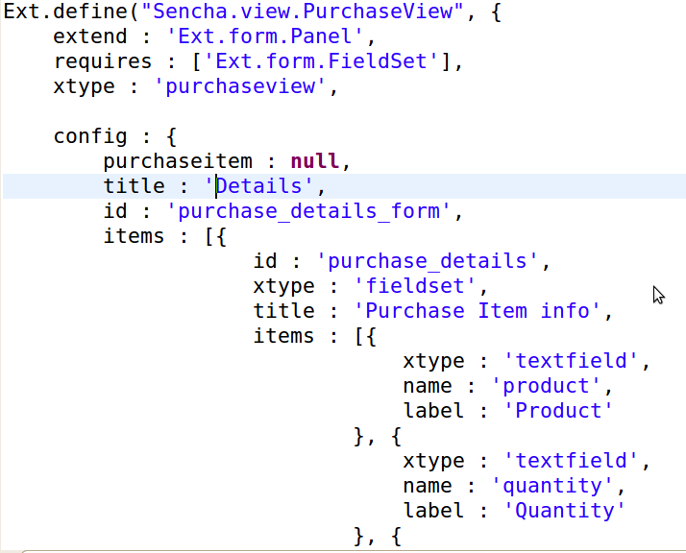
Sencha Purchase List / View

Slide 56
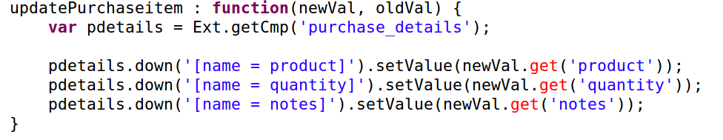
Sencha Purchase List / View

Slide 57
Sencha Purchase List / Controller
Controllers are responsible for responding to events that occur within your app.
If your app contains a Logout button that your user can tap on, a Controller would listen to the Button's tap event and take the appropriate action.
An Application usually consists of a number of Controllers, each of which handle a specific part of the app
Refs and Control configuration
  Refs used to gain references to Components inside your app and to take action on them
  Control is the means by which your listen to events fired by Components.

Slide 58
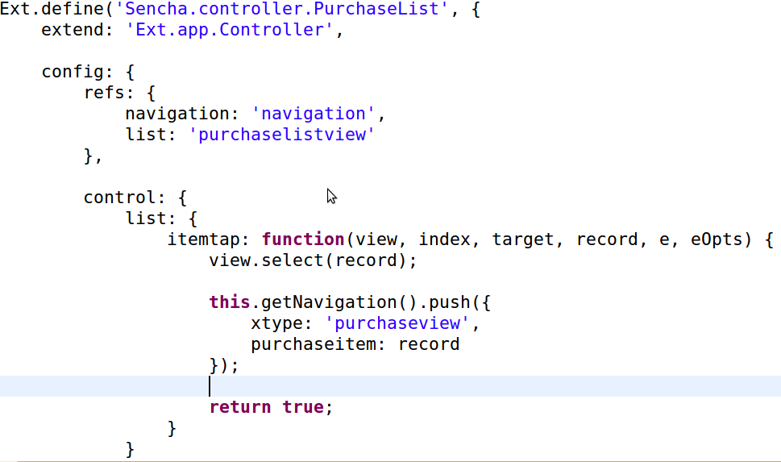
Sencha Purchase List / Controller

Slide 59
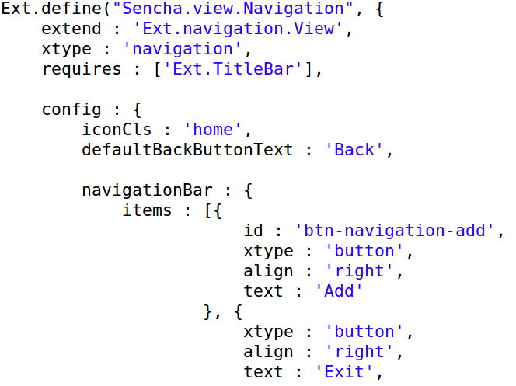
Sencha Purchase List / Navigation
NavigationView is basically - Ext.Container with a card layout, so only one view can be visible at a time. Extra functionality on top of this to allow you to push and pop views at any time

Slide 60

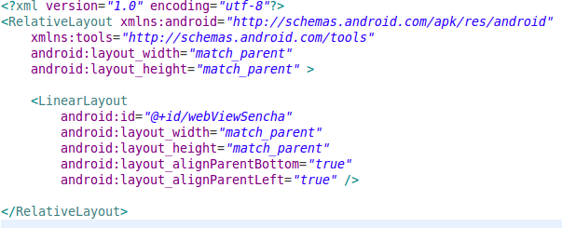

Hybrid Sencha Purchase List
Embed Sencha App into Android WebView
Use packaged / minimized app bundle

Slide 61
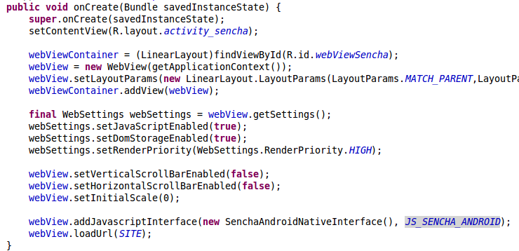
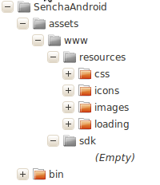
Hybrid Sencha Purchase List
s

Slide 62

Hybrid Sencha Purchase List
Calling native from Sencha (Android)
  webView.addJavascriptInterface(new SenchaAndroidNativeInterface(),”senchaAndroidNative”);

Slide 63
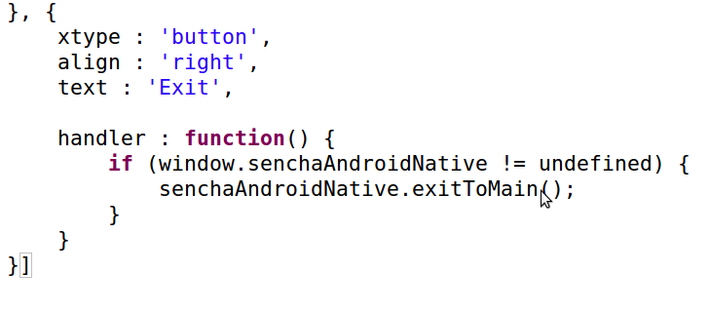
Hybrid Sencha Purchase List
Calling native from Sencha (Secha)

Slide 64
Hybrid Sencha Purchase List
NB! ProGuard
proguard-properties.txt
-keep public class com.example.senchaandroid.SenchaActivity$SenchaAndroidNativeInterface
-keep public class * implements com.example.senchaandroid.SenchaActivity$SenchaAndroidNativeInterface
-keepclassmembers class com.example.senchaandroid.SenchaActivity$SenchaAndroidNativeInterface { <methods>;}

